Slide 1
Face Mask Detection using CNN on Raspberry Pi
Presented by: Kennedy Njoroge

Slide 2

0
Introduction
Why detect mask? Significance?
1
Methodology
Techniques to solve the problem
2
System Analysis and Design
Software and hardware design
2
Implementation
Sensors, data structures, algorithms, actuators, storage
2
System Validation
Validation data and test procedures
2
Deployment Procedure
3
Conclusions
Summary and future work proposals

Slide 3
Introduction
COVID 19
Justification
Why Embedded?
Manual checks for masks by security guards
Opportunity to automate for efficiency
Objective: Create an embedded intelligent system to detect at realtime if a person is wearing a mask or not.
Vision intelligence support
Real time capability
Affordable
Pandemic discovered in Dec 2019 in China
To control spread, authorities recommend wearing mask in public places
Notes:
Crowded facilities - hospitals, churches, malls etc

Slide 4
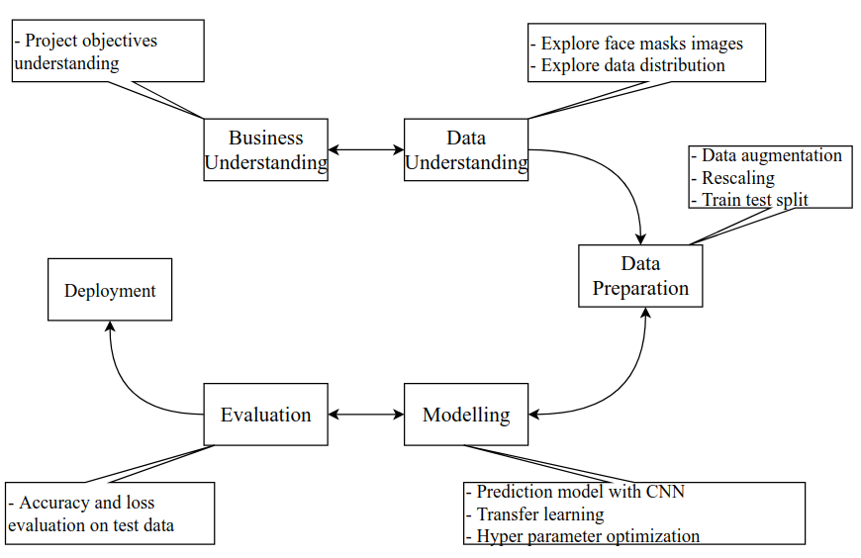
Methodology - CRISP DM
Notes:
Data understanding - Got data from Zindi as well as sourced data from internet or took some via camera to
Data preparation
Modelling - training - used python. CNN to classify mask or no mask.

Slide 5

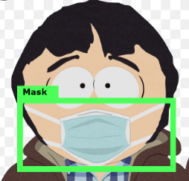
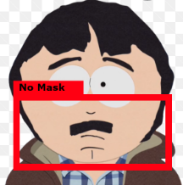
System Analysis - Main functionalities
Real time human face detection
Real time face mask classification
Allow or reject visitor entry depending on outcome
Store images and visit log and determination on memory card
Use affordable embedded device i.e raspberry pi

Slide 6
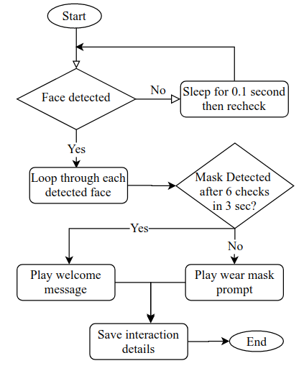
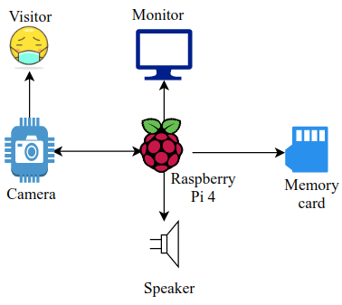
Design - Hardware and Software
Physical Hardware Design
Software Design Flowchart

Slide 7
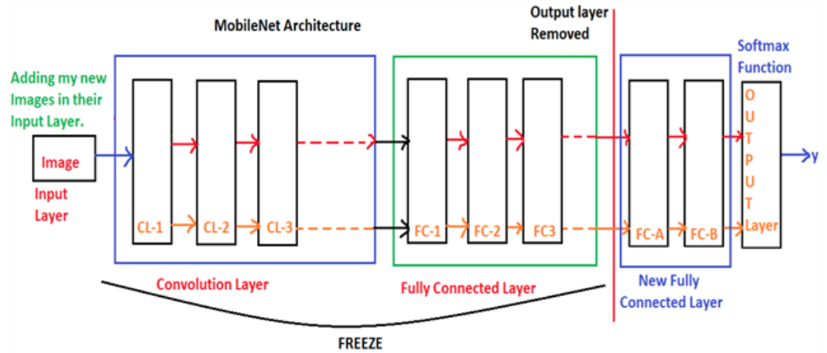
Convolutional Neural Network(CNN) Design
Learnt features from images sourced from Zindi, Google images and local images using CNN (LeCun^{[1]})
Transfer learning applied - Mobilenet
Data augmentation used to create synthetic images

Slide 8
Demo on Raspberry PI
Input Sensors - camera
Data Structures - python dictionary, numpy array
Embedded Intelligence - Open CV_DNN(face), CNN(mask), rules
Actuators - screen, speaker
Storage devices - csv and images on memory card

Slide 9
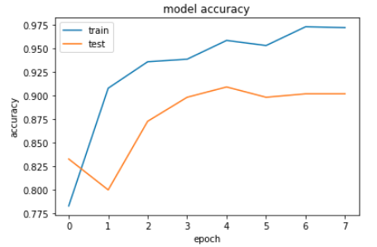
Validation Procedures
80:20 split
Metrics: Accuracy and categorical_crossentropy loss
Training accuracy: 97%, Validation accuracy:90%
Hyperparameter tuning to improve validation accuracy done - Adam optimizer, Learning rate etc. Dropout layer and AveragePooling were added

Slide 10
Results comparison across different model architectures
Model | Training % Accuracy | Validation % Accuracy | Epochs | Full Model Size (Mb) | Tensorflow Lite Size (Mb)
CNN | 91 | 54 | 6 | 177.2 | 59.1
CNN+Augmentation | 56 | 54 | 13 | 177.2 | 59.1
CNN+Augmentation+Transfer Learning | 97 | 90 | 8 | 28.8 | 10.3

Slide 11
Deployment Steps
Compressed model to Tensorflow Lite version
Exported the model from google colab.
Transferred the model via SFTP to Raspberry Pi.
Installed TFLite runtime interpreter and Open CV libraries
Used openCV and CNN model using python to make inference
Bundled model with other RPi built software functionalities e.g image capture from video, audio, results display, logging on csv etc.

Slide 12
Conclusions
Achievements
Deep learning for mask detection using CNN ,data augmentation and MobileNet transfer learning.
Future Work
Temperature detection from infrared images
Explore optimization of low resolution images on RPi to achieve faster inference to ensure no video lag
Integrate with cloud repository for long term data storage

Slide 13
THANKS!
Any questions?
Contacts:
kennjoroges@gmail.com
https://www.linkedin.com/in/kennedy-njoroge

Slide 14
References
LeCun, Yann, et al. "Backpropagation applied to handwritten zip code recognition." Neural computation 1.4 (1989): 541-551.
Krizhevsky, Alex, Ilya Sutskever, and Geoffrey E. Hinton. "Imagenet classification with deep convolutional neural networks." Advances in neural information processing systems. 2012
https://zindi.africa/competitions/zindiweekendz-learning-spot-the-mask-challenge/data, accessed 15th October

